Slide 1
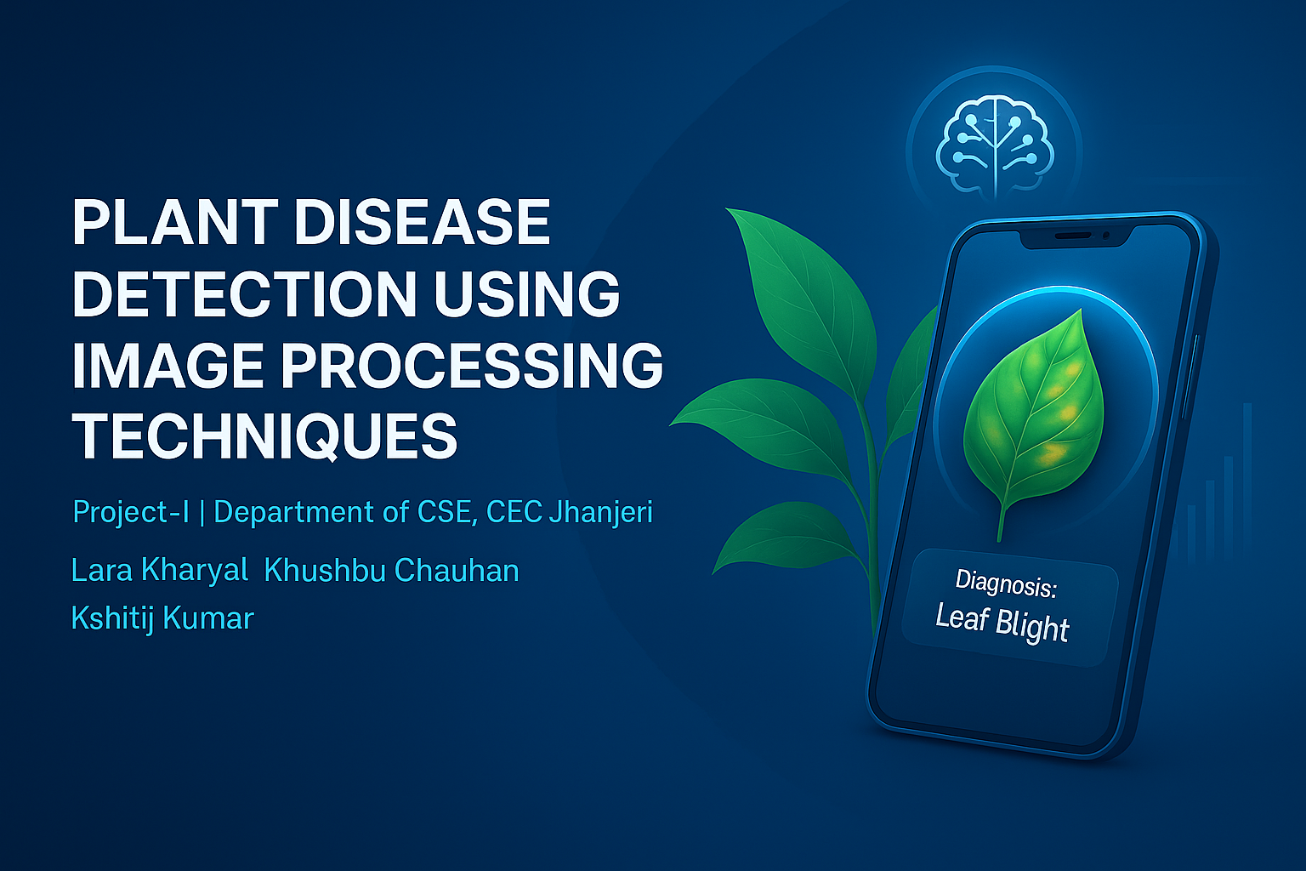
→

Slide 2
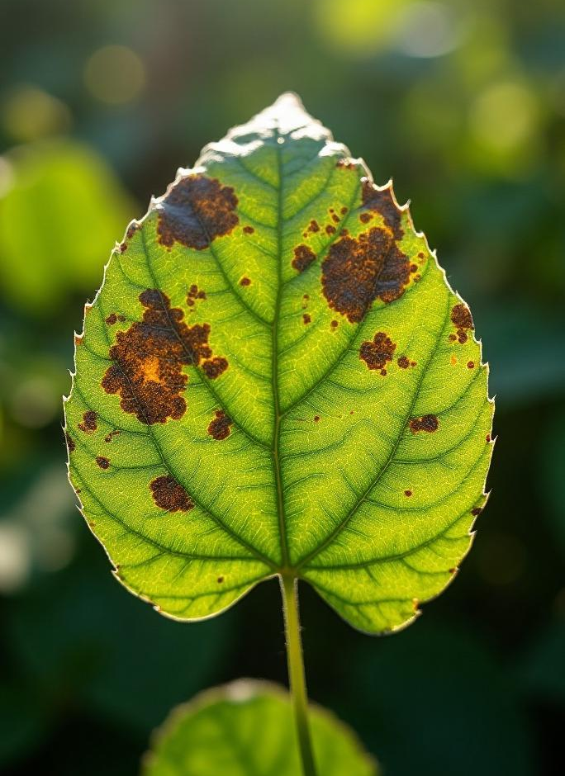
Plant Disease Detector
Utilizing CNN and Image Processing for Accurate Detection

Slide 3
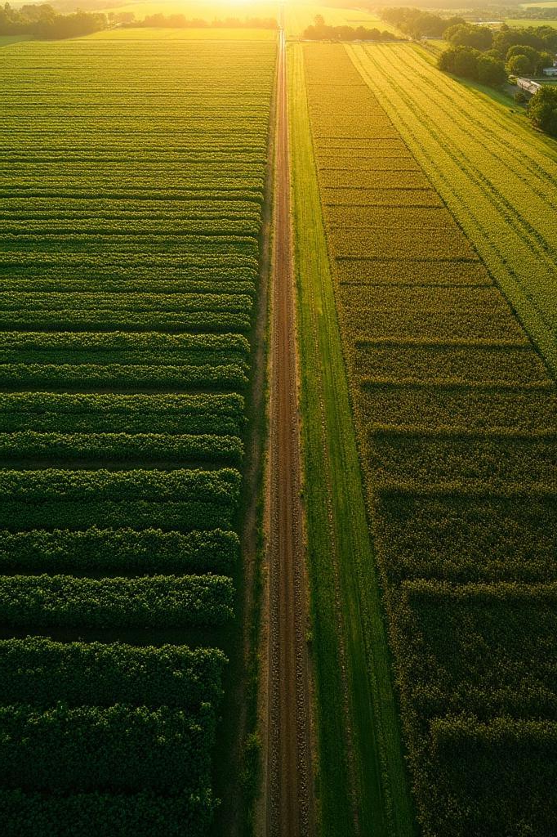
01
Overview

Slide 4
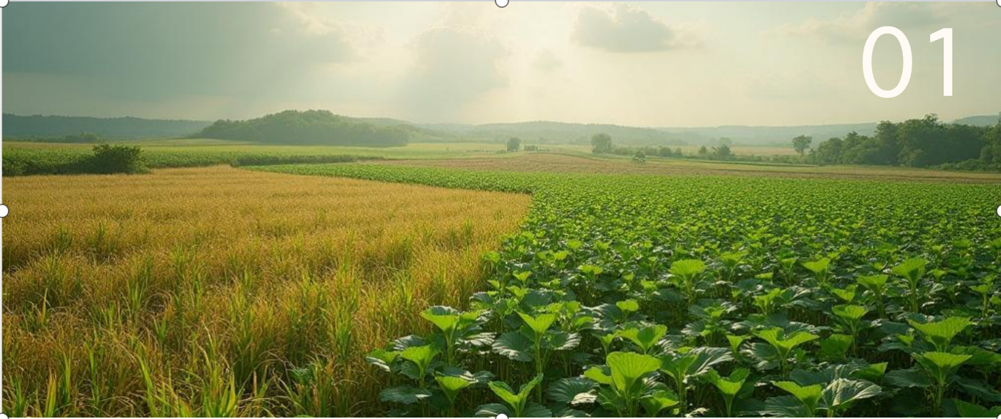
Introduction to Plant Disease Detection
→
Plant disease detection is critical for maintaining healthy crops and ensuring food security. By identifying diseases early, farmers can take appropriate measures to manage and mitigate risks, thus enhancing productivity and sustainability.

Slide 5
Importance of Accurate Detection
→
Accurate detection of plant diseases is vital to prevent economic losses. Misdiagnosis can lead to improper treatment measures, wasting resources and harming the environment. Effective detection can result in healthier crops and better yields.

Slide 6

Overview of the Team Members
Our team consists of experts in the field: Lara Kharyal, Khushbu Chauhan, and Kshitij Kumar, each bringing distinct skills and experiences to the project, ensuring a comprehensive approach to developing the detection system.
↓

Slide 7

02
Technology

Slide 8
Convolutional Neural Networks (CNN)
→
CNNs are a class of deep learning algorithms particularly effective for image analysis. They automatically detect patterns and features in images, allowing for high accuracy in distinguishing between healthy and diseased plants.

Slide 9

Image Processing Techniques
Image processing techniques enhance the quality of input images and improve the analysis. These techniques, such as filtering, segmentation, and feature extraction, are crucial for optimizing CNN performance in disease detection.
↓

Slide 10
Integration with Detection Systems
→
Integrating CNNs with practical detection systems allows for real-time analysis of plant health. By utilizing mobile applications or cloud-based platforms, farmers can receive instant feedback on plant conditions, enabling proactive measures.

Slide 11

03
Application

Slide 12

Real-World Use Cases
Numerous agricultural enterprises have successfully implemented plant disease detection systems using CNNs. For instance, vineyard owners can swiftly identify and address powdery mildew, while farmers growing tomatoes can detect early signs of blight.
↓

Slide 13
Impact on Agriculture
→
The application of advanced detection systems can significantly increase agricultural productivity. By minimizing crop losses, these technologies contribute to securing food supplies, enhancing market competitiveness, and reducing waste.

Slide 14
Advantages for Farmers
→
Farmers benefit from accurate disease detection through better yield potential, reduced pesticide use, and improved crop management strategies. This results not only in financial savings but also in more sustainable agricultural practices.

Slide 15

04
Future Work

Slide 16

Enhancements in Detection Accuracy
Future developments will focus on refining CNN algorithms to improve detection accuracy further. Incorporating larger datasets and advanced techniques will enhance the system's ability to recognize a broader range of plant diseases.
↓

Slide 17
Expanding to More Diseases
→
To maximize effectiveness, the system will be expanded to cover additional plant diseases. Ongoing research will help identify new pathogens and adapt detection technology accordingly.

Slide 18
Collaboration Opportunities
→
Opportunities for collaboration exist with agricultural research institutions, universities, and technology firms. By combining expertise, we can improve disease detection and foster innovation in agricultural technology.

Slide 19

Conclusions
In conclusion, the integration of CNN and image processing techniques in plant disease detection presents significant benefits for agriculture. It promotes higher productivity, better resource management, and opportunities for collaboration, making a substantial impact in the field.
↓

Slide 20

Thank you!
Do you have any questions?
www.yourwebsite.com
↓
CREDITS: This presentation template was created by Slidesgo, and includes icons, infographics & images by Freepik
+91 620 421 838

